Slide 1
RFM Analysis
VARSHA SRINIVASAN

Slide 2
Agenda & Executive Summary of the data

Slide 3
Contents of the ppt
Problem Statement
About Data – Summary Statistics
Exploratory Analysis – Yearly, Weekly, Monthly , Quarterly analysis and Univariate, Bivariate, Multivariate Analysis.
Customer Segmentation using RFM analysis – KNIME workflow and Output Table head
Inferences from RFM Analysis and identified segments

Slide 4
Problem Statement
An automobile parts manufacturing company has collected data of transactions for 3 years. They do not have any in-house data science team, thus they have hired you as their consultant. Your job is to use your magical data science skills to provide them with suitable insights about their data and their customers.

Slide 5
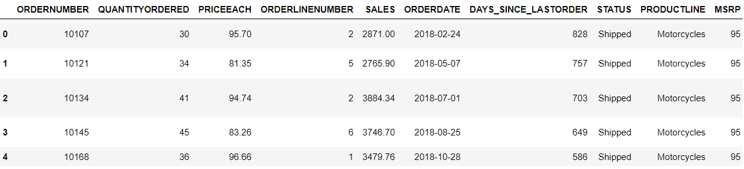
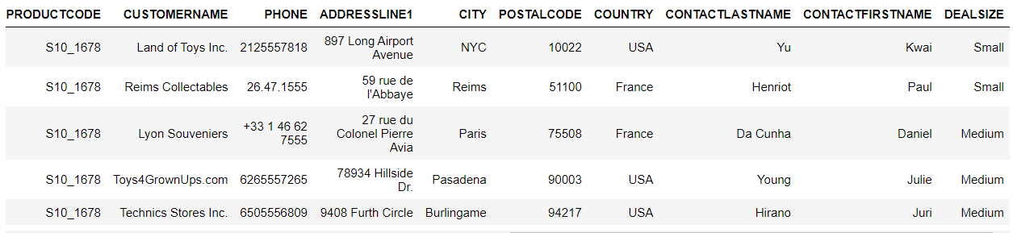
About Data
The first 5 rows of the dataset are

Slide 6
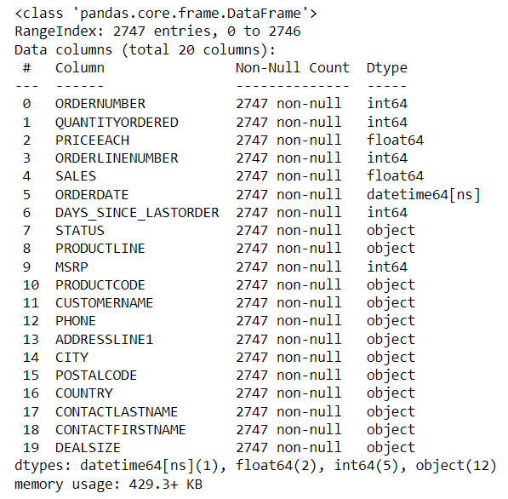
About Data - Info
Info about Data:
Null and Datatype information of each column
in the dataset given by info function in Python.
Dataset contains 2747 records.
There are 20 columns in the dataset.
There are no null values in the dataset.
ORDERDATE is of datetime64[ns] format

Slide 7
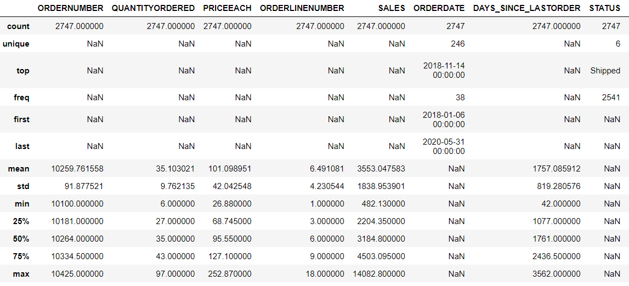
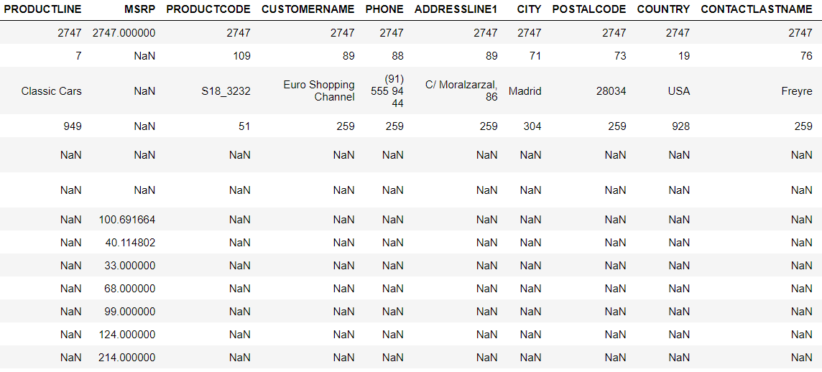
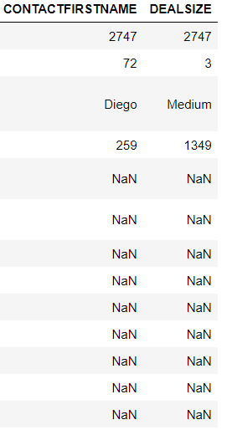
About Data – Summary statistics
Summary Statistics of the data given by describe function in Python is shown below

Slide 8
About Data – Summary statistics
The average sale amount is 3553.
Their most popular product line is Classic Cars.
Most of the customers come from the country USA.
City-wise most of the customers come from Madrid.
Most of the Deal Size is Medium.

Slide 9
About Data
Shape of the Data:
The data has 2747 rows with 20 columns.
There are no duplicates in the data.

Slide 10
Exploratory Analysis & Inferences

Slide 11
UNIvariate analysis

Slide 12
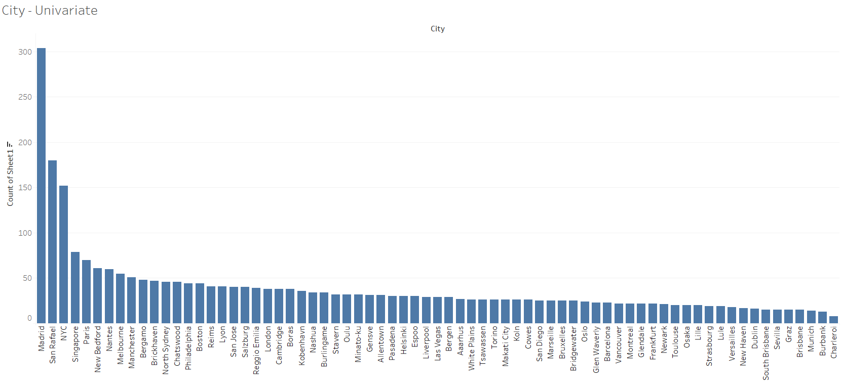
UNIVARIATE ANALYSIS - CITY
Most of the transactions are done by customers from Madrid.
Lowest number of transactions are done by customers from Charleroi.

Slide 13
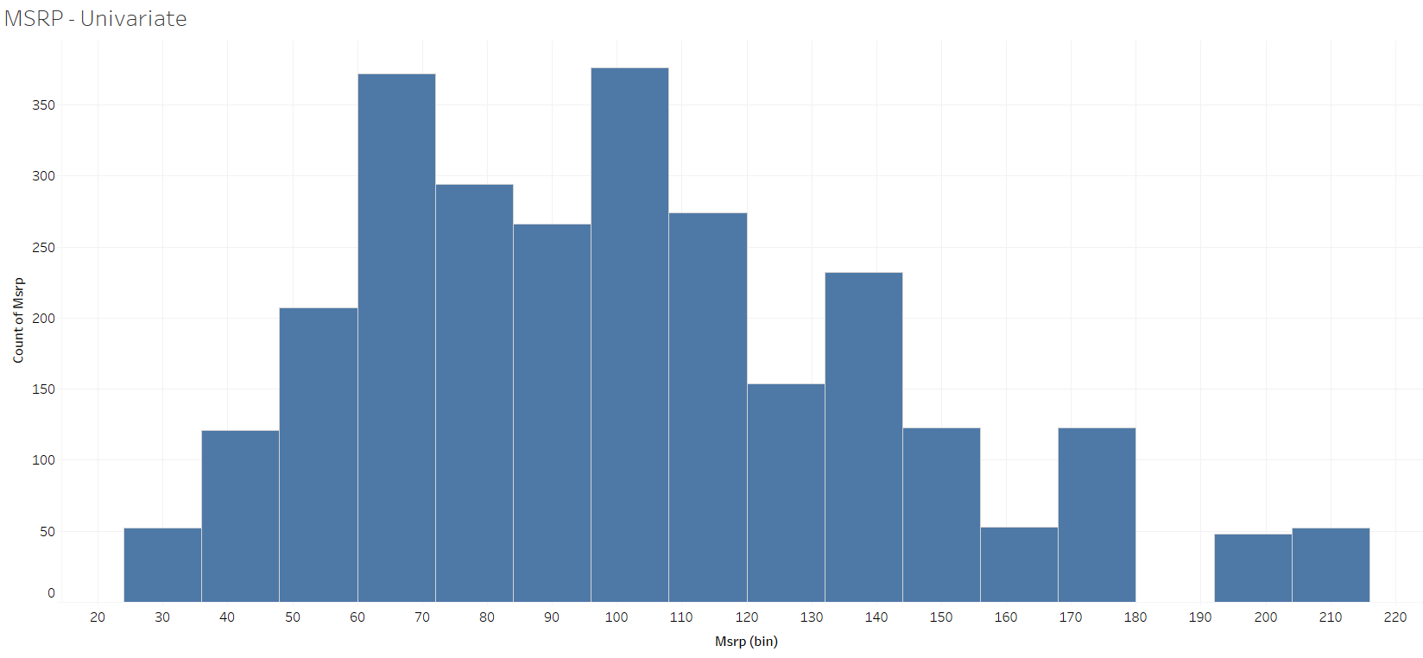
UNIVARIATE ANALYSIS - MSRP
MSRP (Manufacturer's Suggested Retail Price) values are slightly right skewed.
Skewness is also calculated from skew function in python.
For MSRP the skewness is 0.58. Value from 0.5 to 1 mean that it is positively/right skewed.

Slide 14
BIVARIATE ANALYSIS

Slide 15
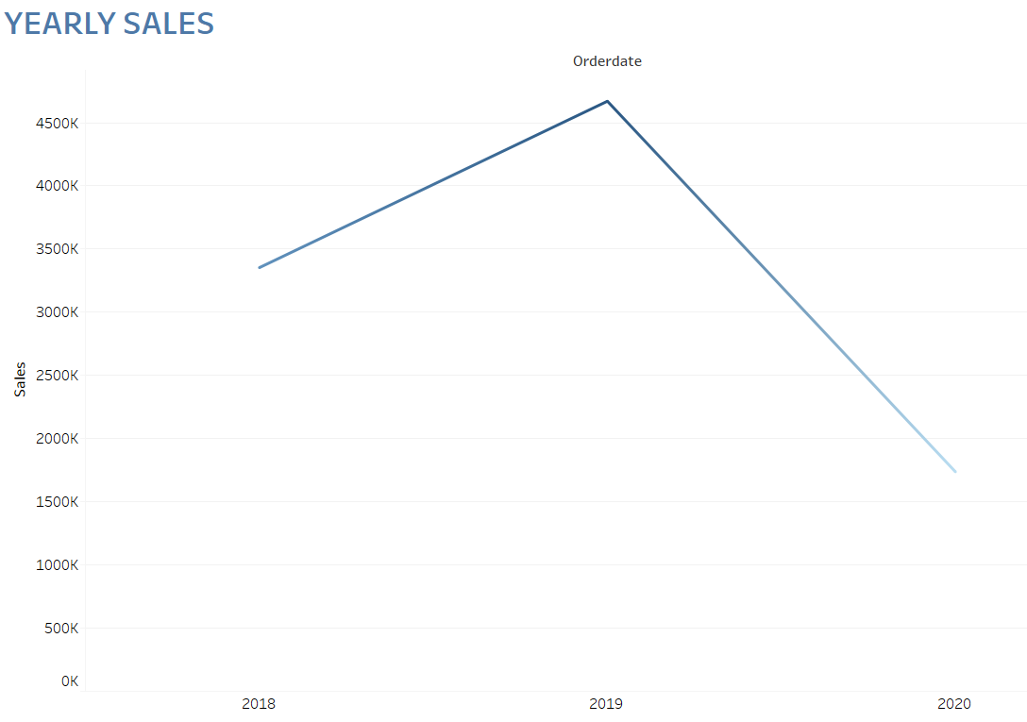
BIVARIATE ANALYSIS – yearly sales
Year 2019 has the highest total sales.
Year 2020 has the lowest total sales.

Slide 16
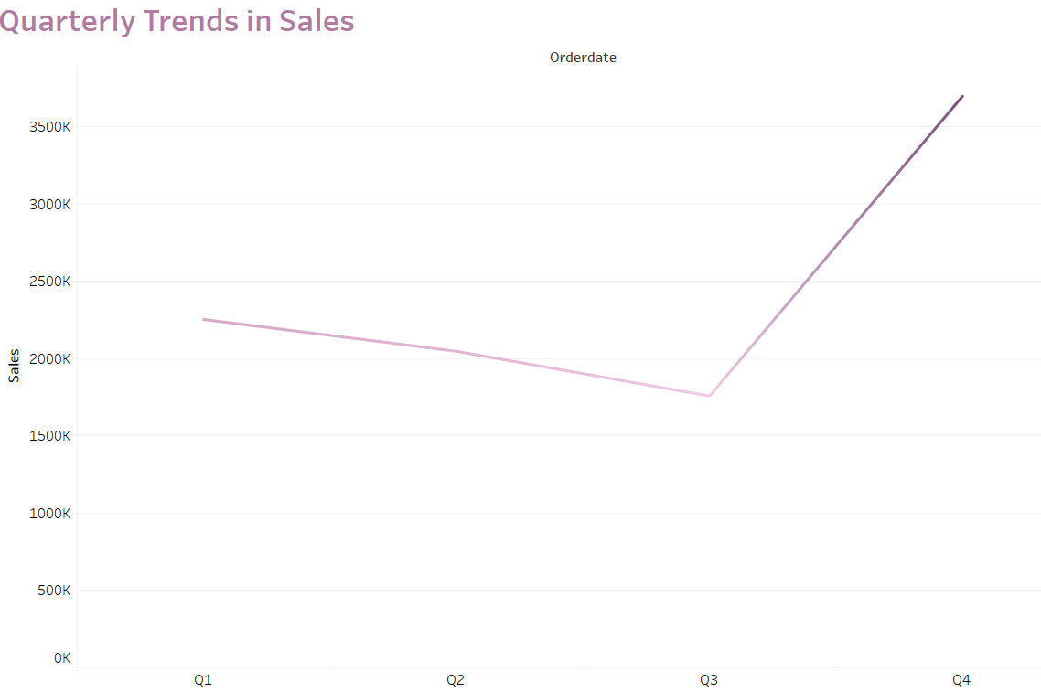
BIVARIATE ANALYSIS- Quarterly sales
The final quarter Q4 has the highest total sales among all the quarters.
Q3 has the lowest total sales among all the quarters.

Slide 17
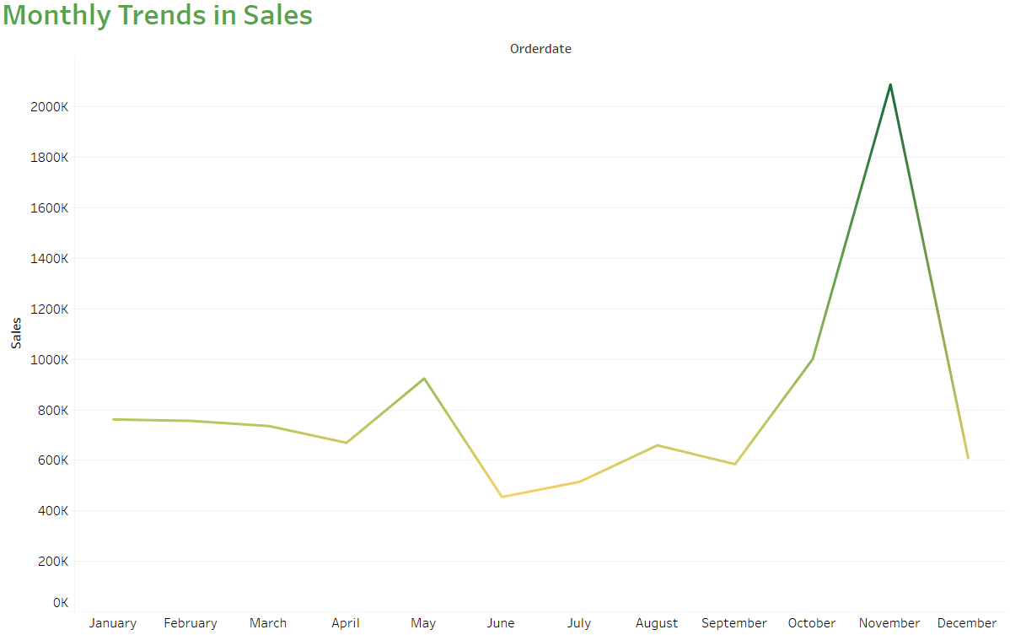
BIVARIATE ANALYSIS- monthly sales
November has the highest total sales among all the months.
June has the lowest total sales among all the months.

Slide 18
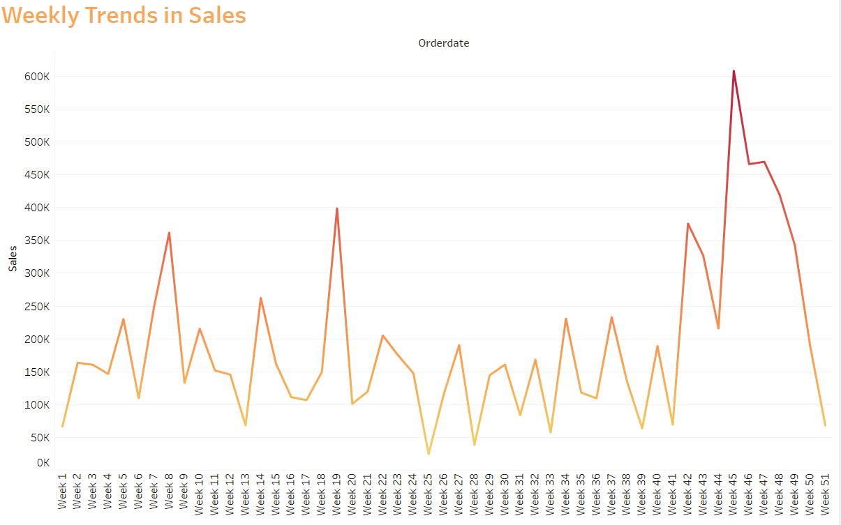
BIVARIATE ANALYSIS- Weekly sales
Week 45 has the highest sales.
Week 25 has the lowest sales.

Slide 19
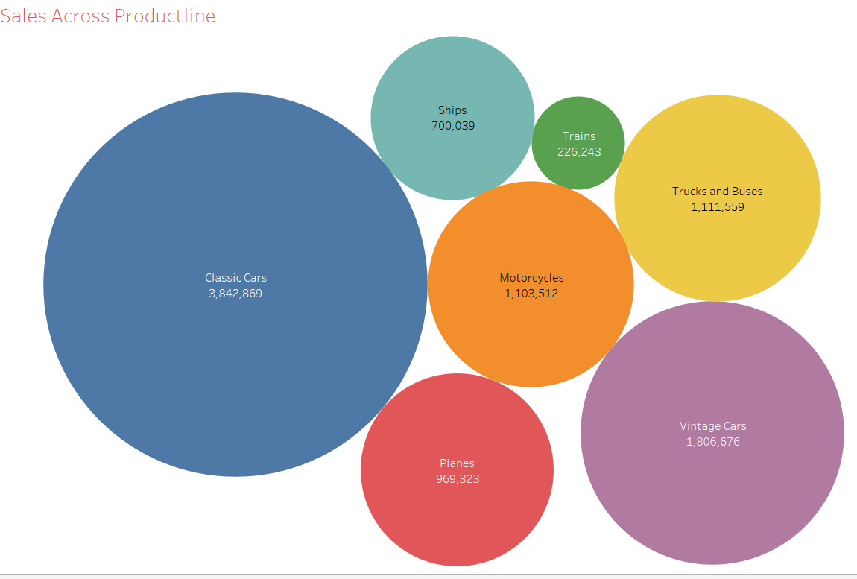
BIVARIATE ANALYSIS - Sales across Product Line
Classic Cars has the highest total sales across other categories in productline.
Trains has the lowest total sales across other categories in productline.

Slide 20
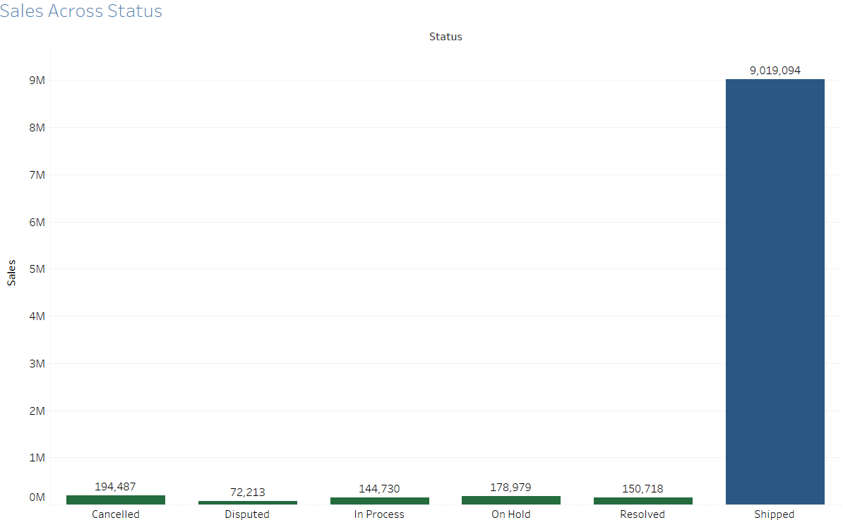
BIVARIATE ANALYSIS – SALES ACROSS STATUS
Shipped orders has the highest total sales.
Disputed Orders are lowest in total sales.

Slide 21
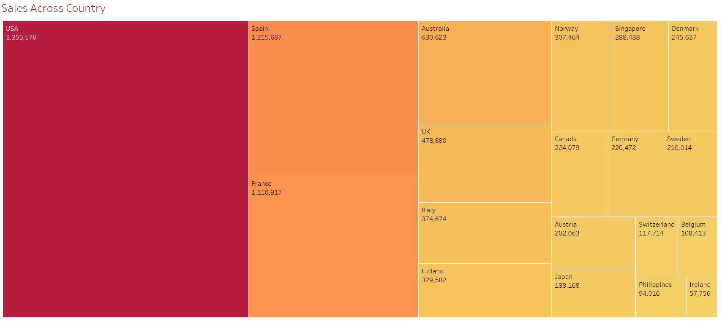
BIVARIATE ANALYSIS – SALES ACROSS COUNTRY
Sales generated from the customers in USA is the highest in total.
Sales generated from the customers in Ireland is the lowest in total.

Slide 22
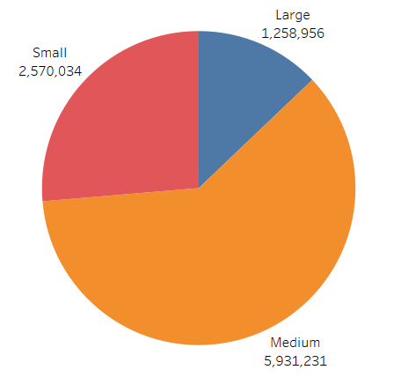
BIVARIATE ANALYSIS – SALES ACROSS Deal Size
Orders of Medium Deal Size has the highest total sales.
Orders of Large Deal Size has the lowest total sales.

Slide 23
Multivariate analysis

Slide 24
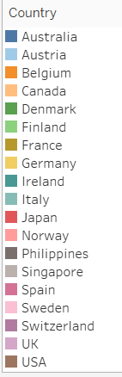
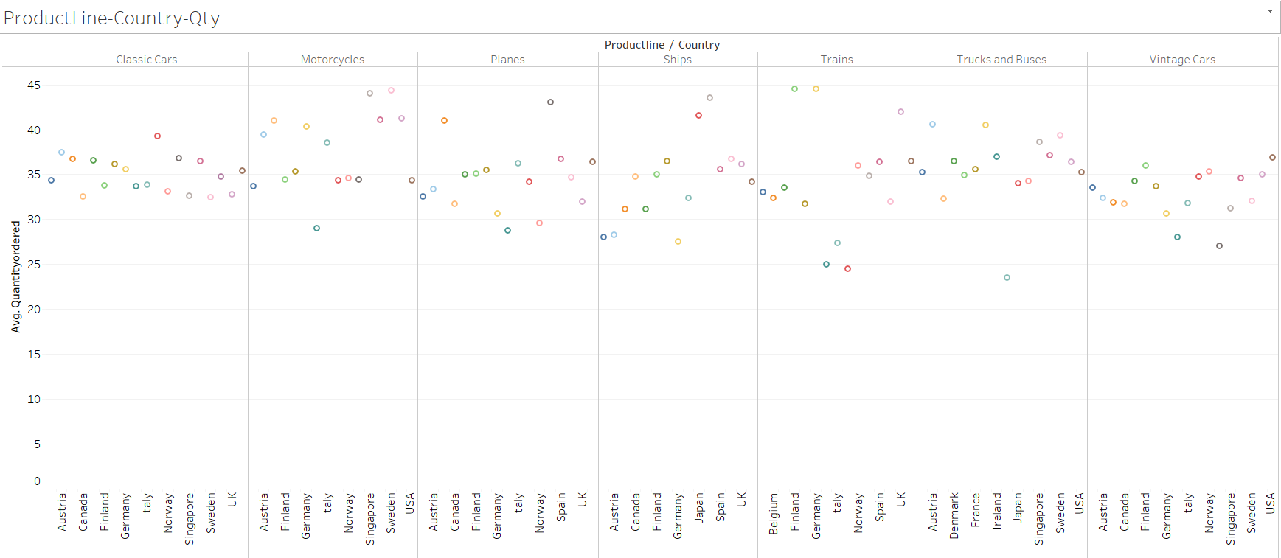
Multivariate ANALYSIS – Product Line-Country-Quantity Ordered

Slide 25
Multivariate ANALYSIS – Product Line-Country-Quantity Ordered
Trains have most of the average quantity ordered by customers from Finland and Germany.
Trucks and Buses have least of the average quantity ordered by customers from Italy.
Classic cars have most of the average quantity ordered by customers from Japan.

Slide 26
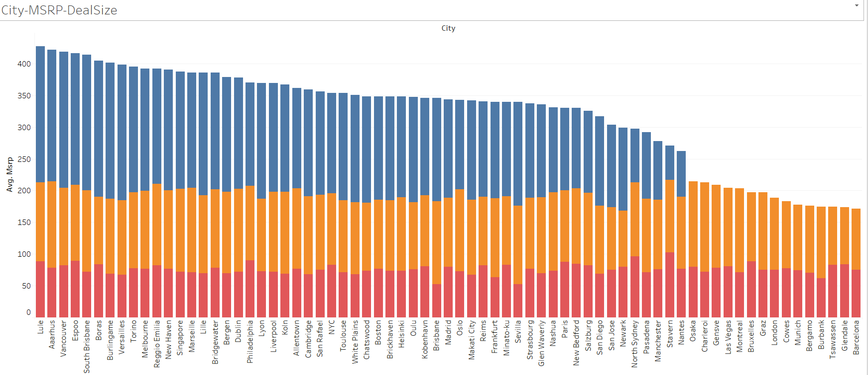
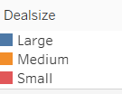
Multivariate ANALYSIS – MSRP-CITY- Deal Size
Customers from Vancouver, Lule , Versailles, Boras, Burlingame, South Brisbane have a large Deal Size with highest average in MSRP (Manufacturer's Suggested Retail Price).
Customers from Brisbane has a small Deal size with lowest average in MSRP.

Slide 27
Customer Segmentation using RFM analysis (4 segments)

Slide 28
What is RFM?
Recency Frequency Monetary Value (RFM) is a quick, descriptive way to segment a marketing database on purchasing behavior that direct marketers have used with success since the 1930s.
It is used to identify a firm's best clients based on their spending habits and perform targeted marketing campaigns.
RFM analysis ranks each customer on the following factors:
Recency: How recent was the customer's last purchase? Business Organizations measure recency in days. Depending on the product it can also be measured it in years, weeks or even hours.
Frequency : How often did this customer make a purchase in a given period? The more frequent the customers the more loyal they are.
Monetary : How much money did the customer spend in a given period? Customers who spend a lot of money are more likely to spend money in the future and have a high value to a business.

Slide 29
What all parameters used and assumptions made?
Unique count of Order number grouped by Customer Name is taken to calculate frequency.
Sum of sales grouped by Customer Name is taken to calculate Monetary.
Recency is computed as Minimum of "[Max(order date) - order date)]“grouped by Customer Name where Max(order date) is assumed as 2020-06-01. Since recency calculates the recent date at which the customer ordered minimum of the date difference is taken.
All the metrics are grouped by Customer Name since we want to look at the data at Customer Name level.
KNIME tool is used to perform the RFM Analysis.

Slide 30
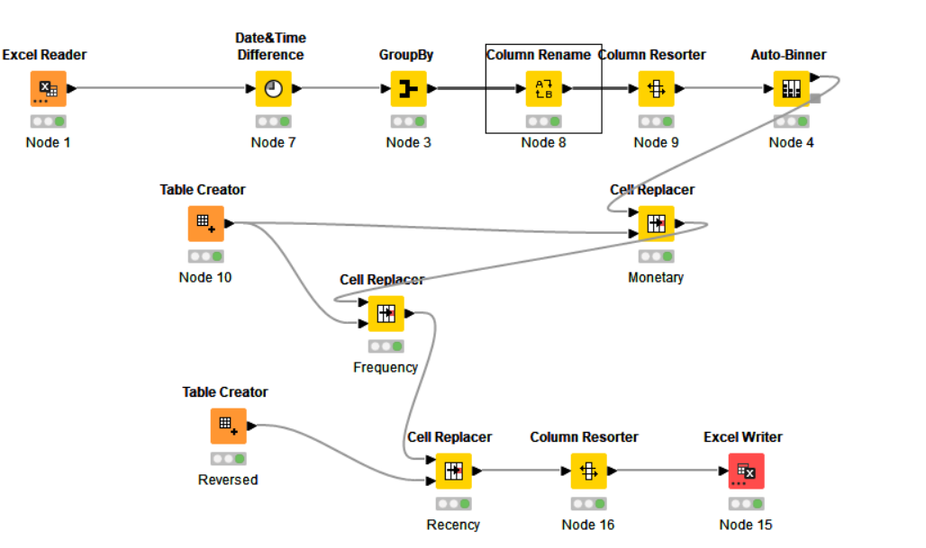
Knime workflow
Excel reader node is used to read the data from the Sales_Data excel file and the data is passed to Date&Time Difference is used to calculate the difference between the order date and ‘2020-06-01’.
Group by function is used to calculate the column values grouped by Customer Name.
Column rename is used to rename the RFM calculated columns as Recency , Frequency and Monetary. Column Resorter is used to rearrange the columns in the data.
Auto Binner is used to assign values lying between 0 and 0.25 quantiles as Bin 1, 0.25 and 0.5 quantiles as Bin 2, 0.5 and 0.75 quantiles as Bin 3, 0.75 and 1.0 quantiles as Bin 4.
Table creator is used to define the map Bin 1 to 1, Bin 2 to 2, Bin 3 to 3 and Bin 4 to 4 for Monetary and Frequency.
Table creator reversed is used to define the map Bin 1 to 4, Bin 2 to 3, Bin 3 to 2 and Bin 4 to 1 for Recency.
Cell Replacer replaces the bin values as stated above in the data.
Excel writer writes the updated data into an excel file in our local system.

Slide 31
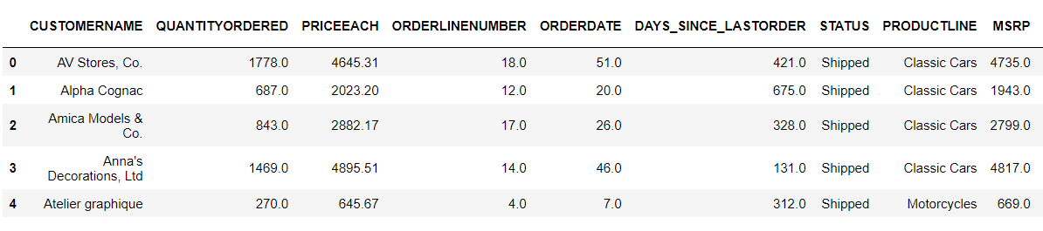
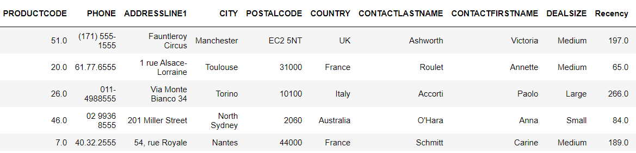
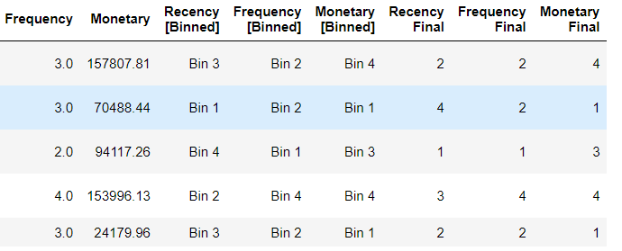
Output table(with rfm) head
The output table of KNIME has the RFM values ranging from 1 to 4 where 1 denotes the lowest value and 4 the highest. As the value increases denotes the increase in monetary, recency and frequency.

Slide 32
Inferences from RFM Analysis and identified segments

Slide 33
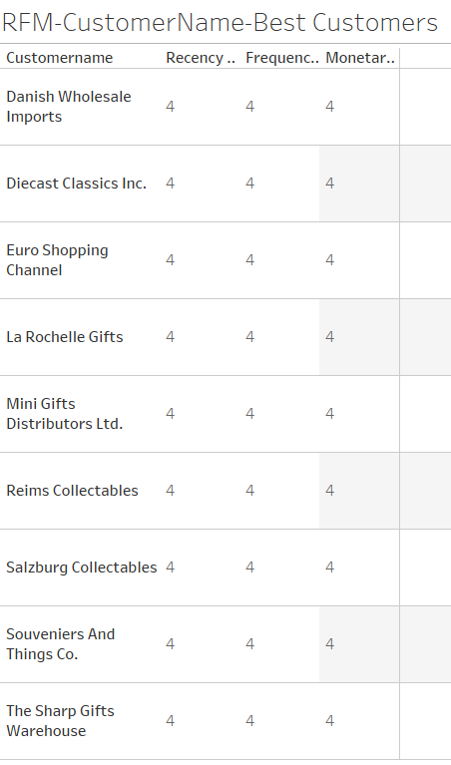
Who are your best customers?
The Recency , Frequency and Monetary columns has values 1,2,3,4.
Value 4 denotes most recent, most frequent and high monetary value.
Value 1 denotes least recent, least frequent and low monetary value.
Best customers are the one with value 4 in Recency , Frequency and Monetary.
Some of the best customers are Danish Wholesale Imports, La Rochelle Gifts, Reims Collectables, Saizburg Collectables, The Sharp Gifts Warehouse.

Slide 34
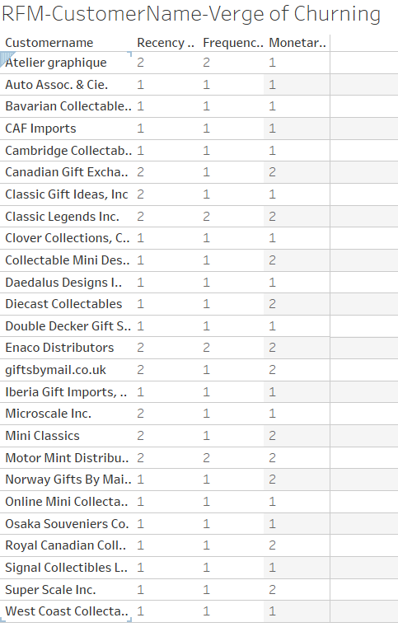
Which customers are on the verge of churning?
The Recency , Frequency and Monetary columns has values 1,2,3,4.
Value 4 denotes most recent, most frequent and high monetary value.
Value 1 denotes least recent, least frequent and low monetary value.
Customers on the verge of churning are the one with values 1,2 in Recency , Frequency and Monetary.
Some of those customers are Atelier Graphique , Canadian Gift Exchange Network , Mini Classics, Super Scale Inc., Microsale Inc..

Slide 35
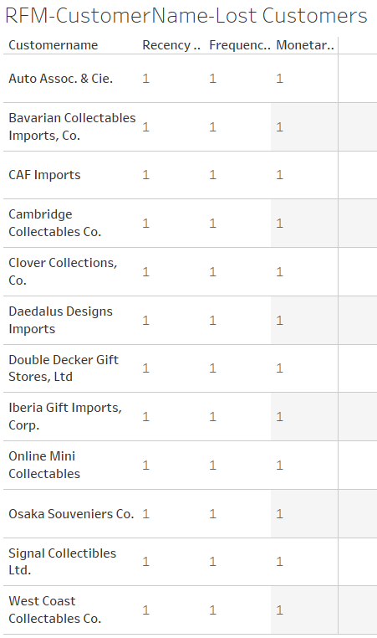
Who are your lost customers?
The Recency , Frequency and Monetary columns has values 1,2,3,4.
Value 4 denotes most recent, most frequent and high monetary value.
Value 1 denotes least recent, least frequent and low monetary value.
Lost customers are the one with value 1 in Recency , Frequency and Monetary.
Some of the lost customers are CAF Imports, Online Mini Collectables, West Coast Collectables Co., Signal Collectibles Ltd., Cambridge Collectables Co..

Slide 36
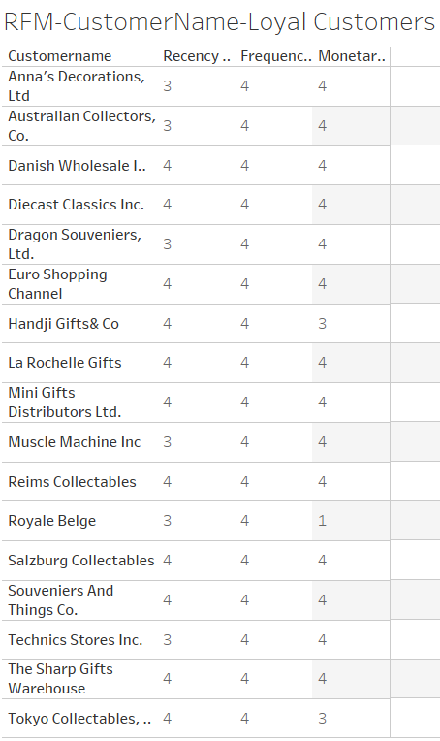
Who are your loyal customers?
The Recency , Frequency and Monetary columns has values 1,2,3,4.
Value 4 denotes most recent, most frequent and high monetary value.
Value 1 denotes least recent, least frequent and low monetary value.
Loyal customers are the one with value 3,4 in Recency,Monetary and Frequency.
Some of the loyal customers are Technics Stores Inc., Dragon Souveniers Ltd., Muscle Machine Inc., Australian Collectors Co. , Anna’s Decorations Ltd..

Slide 37
THANK YOU

